Slide 1




Sustainability of the Upper San Pedro River due to Climate and Population Variability
Luis H Huizar Jr
Department of Chemistry
University of Arizona
UA/NASA Space Grant Symposium
April 17, 2010

Slide 2
Special Thanks to:
Kevin E. Lansey, Ph.D., Mentor, UA Civil Engineering and Engineering Mechanical Department Head
Doosun Kang, Ph.D., UA Civil Engineering and Engineering Mechanical Research Assistant Professor
UA/NASA Space Grant Internship

Slide 3
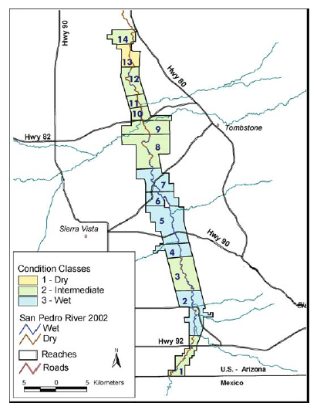
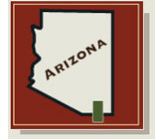
Upper San Pedro River Location

Slide 4
Problem Statement
San Pedro River has larger withdraws than the natural recharge amount
To achieve sustainability in the San Pedro River
Objective

Slide 5
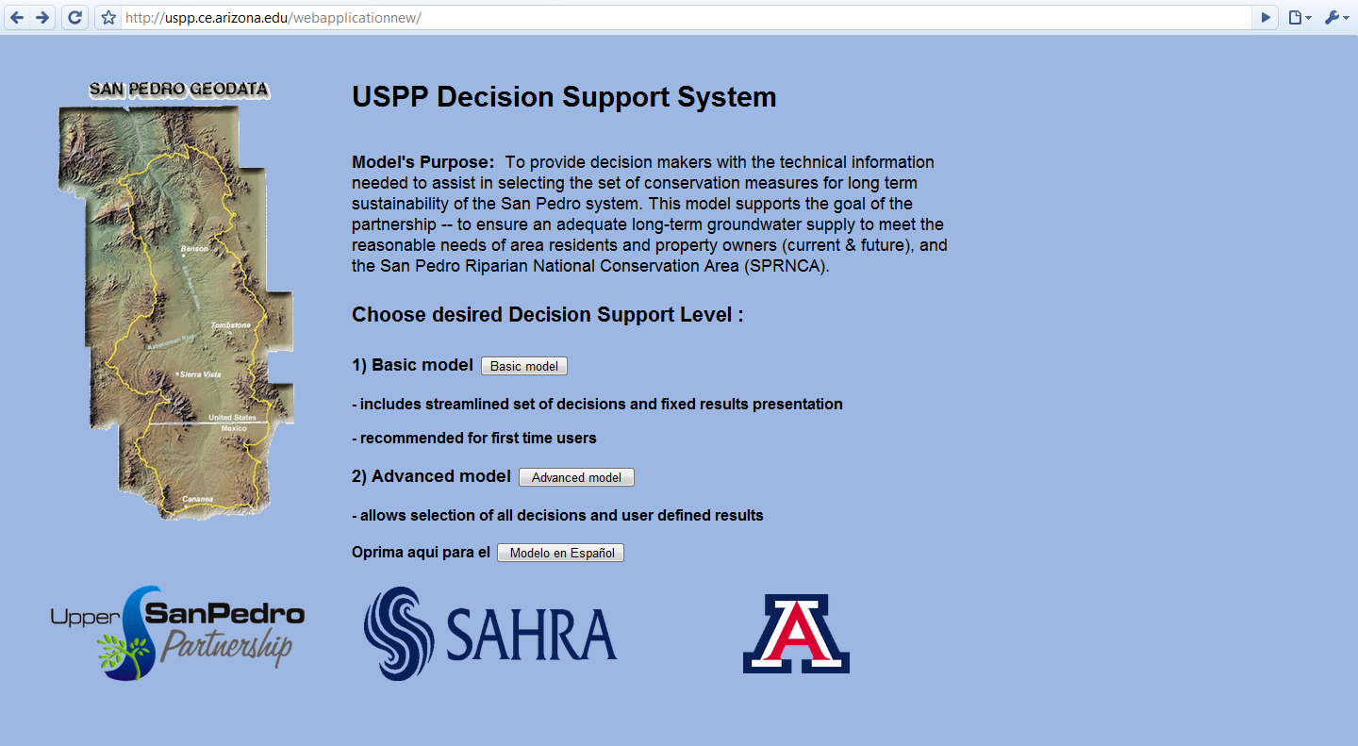
USPP Decision Support System

Slide 6
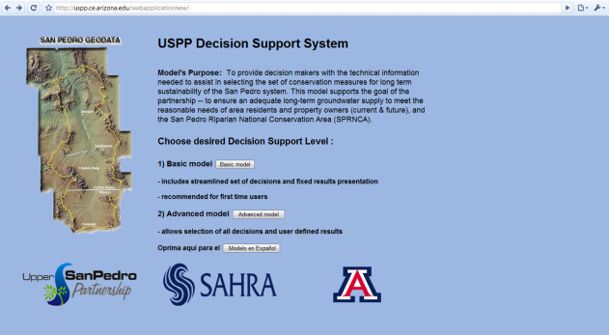
Support System Aspects
- Translation into Spanish
- Population by Regions
- Population Growth rate
- Climate Additions
Website
PowerSim Model
Database

Slide 7
Location

Slide 8
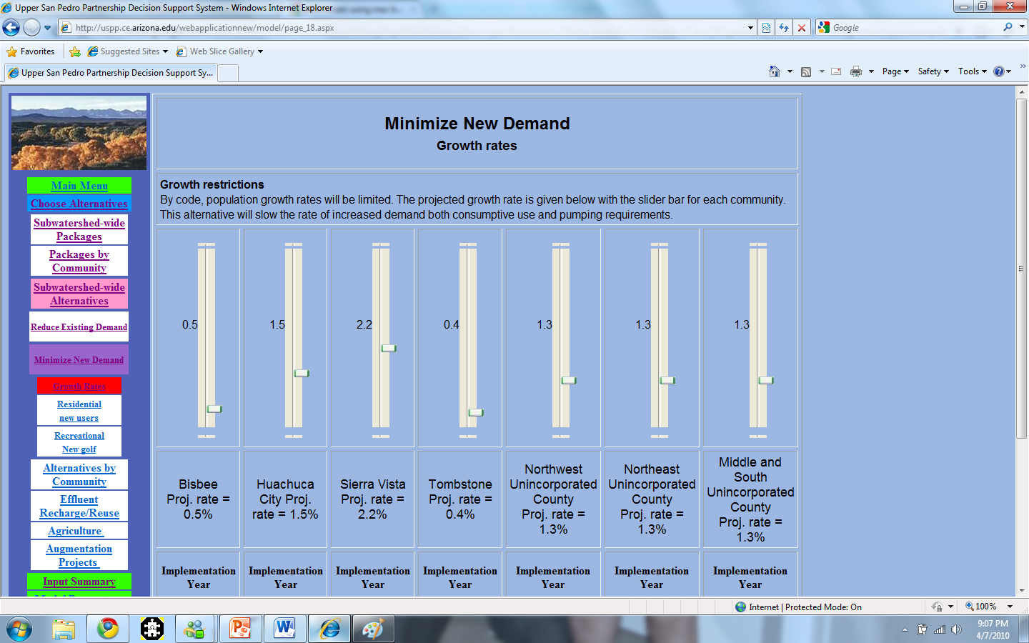
Population

Slide 9
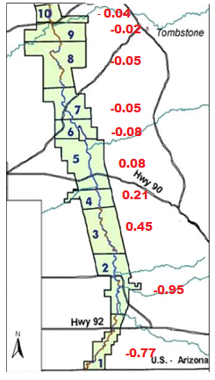
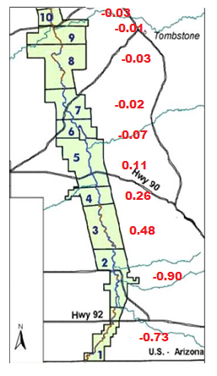
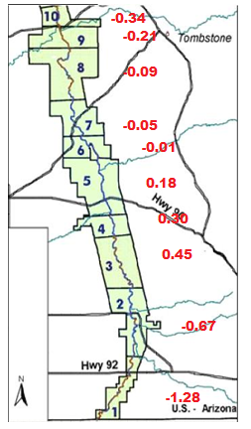
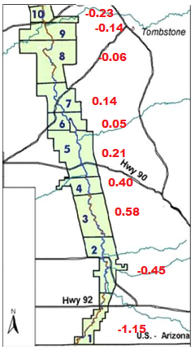
Change in Ground Water Levels
2010
2010
W/ Package
2030
2030
W/ Package

Slide 10
Climate Variability
Aleix Serrat Capdevila (HWR, UA)

Slide 11
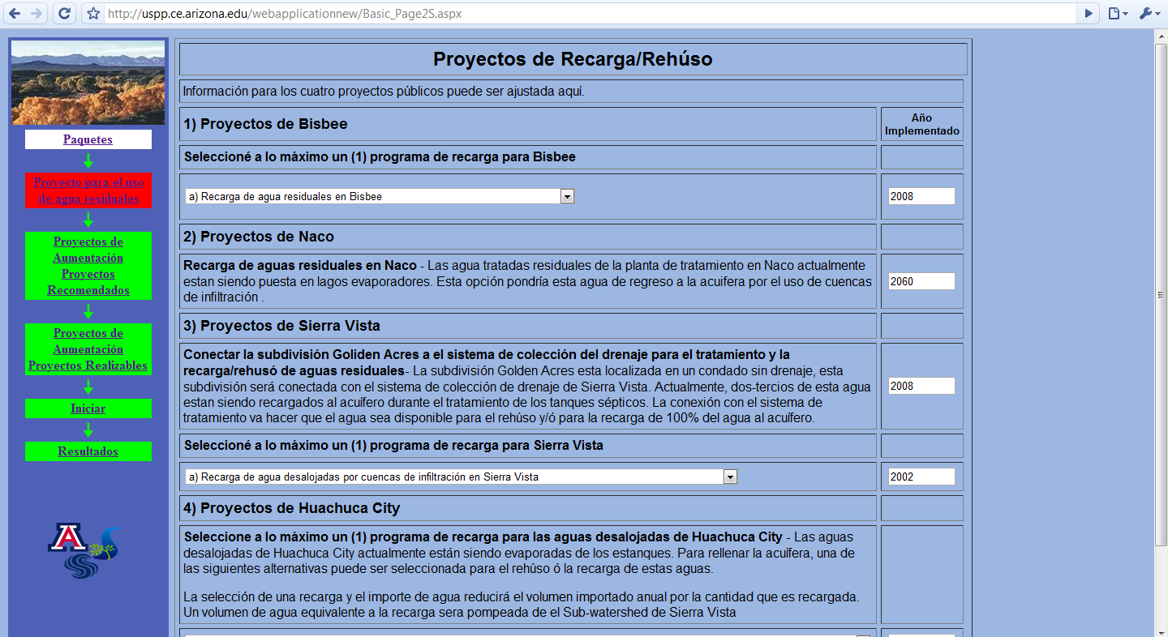


Spanish Model
USPP DSS Website: http://uspp.ce.arizona.edu/webapplication1/

